Slide 1

Jump Up
By
Team RAISA
GUIDED BY: PROF. Andrew Huy

Slide 2
Content
Problem Statement
What is Crowd Funding
Importance of Crowd Funding
What is pledging?
Functional Features
Proposed Solution
Implementation
Demo

Slide 3
Problem Statement
Reasons for Start-Up Failure
Product that doesn’t meet the market need.
Lack of sufficient capital.
Lack of Business Understanding
Lack of Concept of Reality
No Backup Plan
No Exit Strategy
In the normal scenario, it will take a few revisions to make it suit the market needs.
In the worst case scenario, a complete re-think is required.

Slide 4
What is Crowd Funding
Each individual gives small donations in terms of money
When a company gets thousands of donors, they achieve capital threshold.
Importance of Crowd Funding
Development: Helps companies to promote their project to the next level both, “Capital” and “Market Needs”
Deployment: Helps startups in rolling out a product or service.

Slide 5
What is pledging?
The users back a particular project which suits their interest.
Users donate resources to the project in order to help the team.
Minimum Pledge Amount ➔ 1 point
Companies gives rewards for certain amount of donation.
For example: Games Development Company
$50 ➔ Free Game Access for 1 month
$100 ➔ Free Access to Beta Version
$500 ➔ Free Game Access for Lifetime.

Slide 6
Functional Features
User authentication and login.
Persisting user data during registration in the database.
Start the project with all the relevant details.
Collect real time statistics of the funds gained by the project.
Support for different domains of projects
Each user irrespective of sign in, designation should be able to see all the projects.
Wish list of projects.
Trending projects.
Future Plan (Customer support, Newsletter)
Personalized recommendations

Slide 7
Proposed Solution
Fund raising website that helps startups, to advertise their projects to people.
Investors Log-in to view different registered projects.
Open Source: Project code made available on GitHub for customers.
Diversity of projects.
Real time statistics of funds raised.
Ability to add collaborators to project.
Kick Starter ➔ Base for our idea.

Slide 8
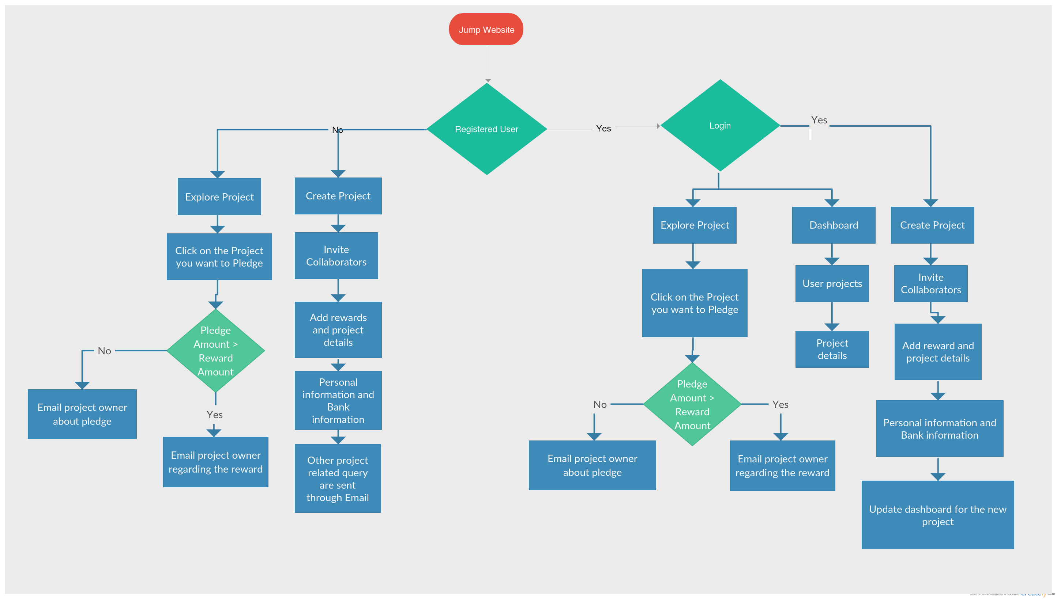

Slide 9
Implementation
Backend: Python
Database: Postgresql
Image Storage: Amazon S3
Frontend: Html & CSS
Deployed On: Heroku
Website Address: jumpup.herokuapp.com

Slide 10


